Slide 1
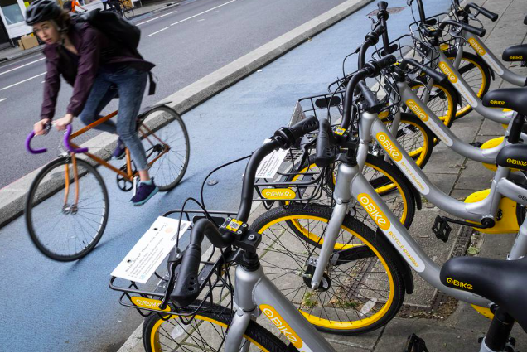
Cyclistic Bike-Share Analysis
Presented by: Chukwudi Ekweani
Last Updated: August, 31st 2022
Notes:
So this is the presentation that I have put together on the Fictitious Bike-sharing company called Cyclistic Bike-Share.

Slide 2
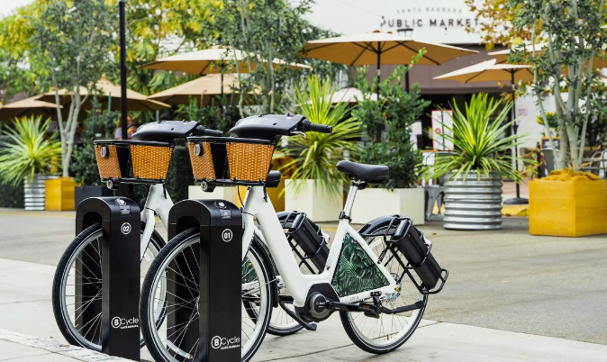
Cyclistic Bike-Share Analysis
TABLE OF CONTENT
Purpose statement
Tell your story
Conclusion
Recommendations
Notes:
In this presentation, we are going to be looking at the purpose statement in which we are going going to be discussing the business task and objective of this presentation.
Then we delve into the story the data is narrating by looking into the insights that will enable us make our discussion.
We will then go into a summary of everything discussed before finally nailing it down to the recommendations I’ve made as pertains the data story.

Slide 3
PURPOSE STATEMENT
Notes:
Let’s go into the purpose statement.

Slide 4
GOAL
OBJECTIVE
To Design Strategies Aimed At Converting casual riders Into members
To find out how members use cyclistic bikes differently from casual riders
Notes:
Casual are riders who purchase a full-day passes or single rides, while members are customers that purchase annual membership.
The goal of this analysis is to strategize on how to convert casual riders into members and we can do this by finding out how members use cyclistic bikes differently from casual riders.

Slide 5
DATA PRESENTATION
Notes:
Now let’s present our findings.

Slide 6
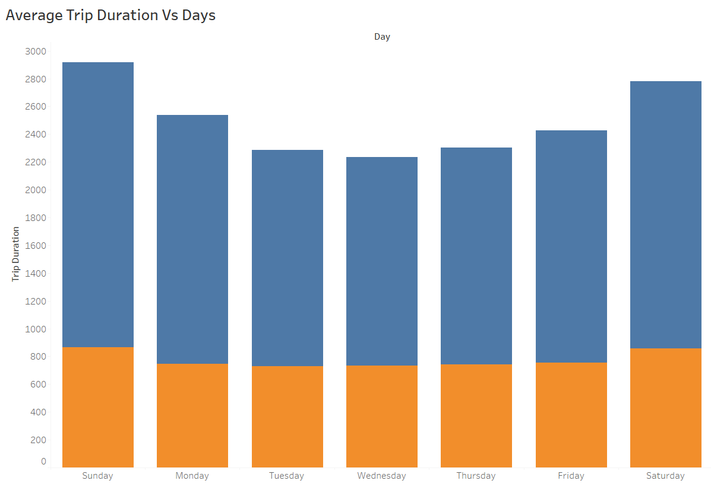
Higher Averages
Average Trip Duration Across the Week
Casual
Member
Casual riders ride for longer duration than members
Casual riders and members ride longer during weekends
Days of the week
Notes:
First, we are going to look at the trip durations of both members and casual riders
In our column graph, you observe that we have the blue bars at the top which represents the casual riders and the orange bars at the bottom which represents the members. On the left, we have the vertical axis which represents the average ride-time. The time increases as we go up the axis.
We found out that casual customers ride for longer time periods as in contrast to their counterparts, the members.
This trend is consistent along the week.
But if we look at the members, the time duration is roughly consistent along the week with contrast to the casual riders which is steep with highest time duration during the weekends.
Next, we are going to compare the bike trip requency of these two groups of customers.

Slide 7
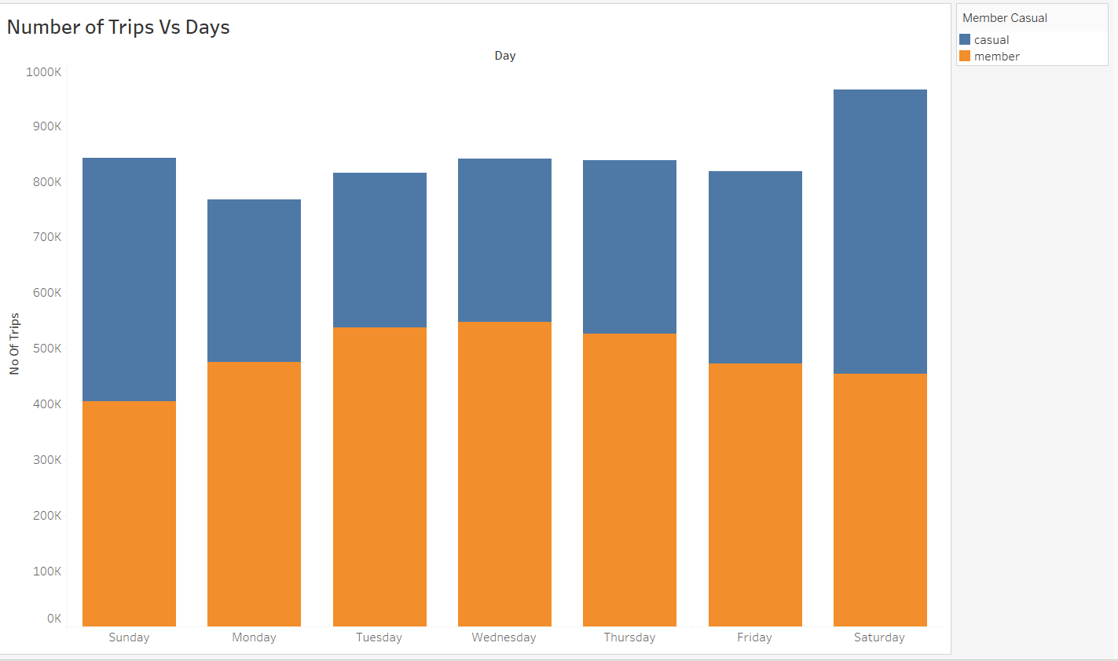
Number of trips increases
Number of Trips
During the weekdays, members are more frequent riders than casual riders
Casual riders are slightly more active during the weekends than members
Notes:
Similar to the previous chart, this is also a column chart with the blue represents the casual customers while the orange represents the members, but this time, we are looking at the the number of trips in the vertical axis. The chart shows that members are more frequent riders than casual customers and while the frequency of trips falls during the weekends for the members, it rises for the casual riders. This shows that casual riders are more active during the weekend than members.
Next, we are going to look at prefered bike types by the two groups of customers.

Slide 8
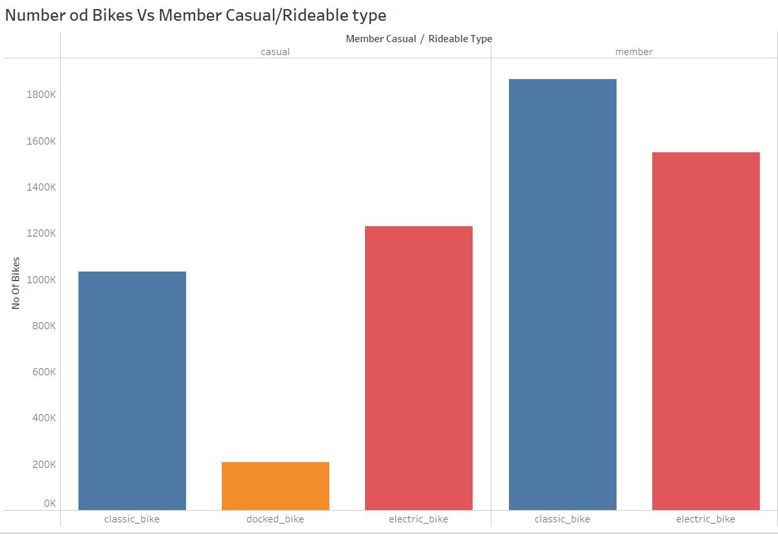
What Bikes Do They Opt For?
Members patronize the classic bikes more than the electric bike
Casual riders patronize the electric bikes more than the classic bikes.
Casual riders show affinity for the docked bikes while members show no affinity for the docker bikes
Notes:
It is no surprise that members have higher usage of bikes that casual riders.
Members prefer the classic bikes more than the electric bikes while the reverse is the case for the casual riders.
But one thing we should take note of is the docker bikes used by casual riders even though is a small percentage.
Next, we will be looking at bike activities throughout the year.

Slide 9
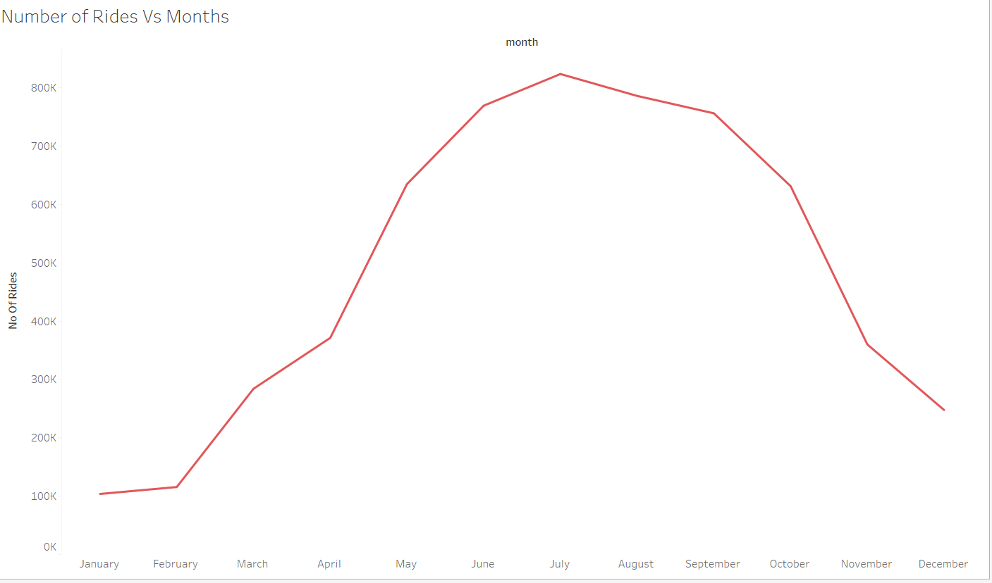
Cycling Activity Through the Year.
There is more cycling activity during the summer and declines as winter approaches.
Increase in biking activity
Notes:
From the line chart, the vertical axis records the biking activities in each month which is represented in the horizontal axis.
There is slow climb of bike activities from January to July which is the peak of bike activities, and then it begins to fall as it approaches December.
June, July, August and September are high periods for riders because of the summer, while bike periods fall during Autumn and Winter periods.

Slide 10
CONCLUSION

Slide 11
Conclusions
1
2
3
Casual riders use cyclistic bikes mostly for recreational activities in contrast to members that use it as a lifestyle.
Only the casual riders have interest in the docked bikes and most of them prefer the electric bike as to the classic bike.
Cyclists prefer to ride in Summer than in Autumn and Winter.
Notes:
Therefore we can conclude that:

Slide 12
RECOMMENDATIONS

Slide 13
Recommendations
Create a social media handle to promote the value of bike-riding to the environment and health.
Make the electric and docked bikes available for members with a percentage discount. This discount will only be available if a customer opts for membership. This will attract riders to become members.
Promotions should start at spring through summer since these are the peak periods.

Slide 14
THANK YOU

